Slide 1

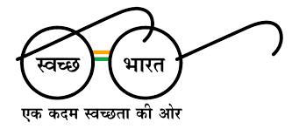

eग्रामपंचायत
One step towards आत्मनिर्भर भारत

Slide 2
Problems faced by traditional System
2
Following problems encoutered in traditional system of Grampanchayat:
Records of revenue taxes paid by villagers are maintained by paper work.
People don’t follow deadlines to pay revenue taxes.
Workers of Gram Panchayat have to circulate bills of revenue taxes by visiting each house.
Need to visit panchayat office no. of times for resedential certificate.
No awareness about latest schemes of govt. for farmers,villagers.
Quarrels between villagers and officer if any record has been missed out.

Slide 3
Solutions from our system
3
Features of our system to overcome those problems:
Online and secure payment gateway to pay revenue taxes online.
Provide receipt of payment in pdf format.
Floating a govt. schemes on website to provide awareness among villagers.
Admin dashboard to maintain transaction data of revenue taxes and decide revenue taxes.
Villagers can apply for residential certificate online.
Villagers will get certificate through email after complete process.

Slide 4



Scope of project
Short-term goals
Limitations
Milestones
4
Develop a secured web application for revenue payments.
Need of large database, uneducated villagers, security of payments.
Develop a notification floating system and certificate approval module and get approval from govt. to use in grampanchayat.

Slide 5


Scope of project
Top-level requirements
Future Scope
5
Large no. of user’s document verification for residential certificate, advanced payment gateway.
Develop a Integrated system to function for all gram panchayat offices in disctrict.

Slide 6
Stakeholders
01
02
03
6
Villagers.
Gram-Panchayat officers.
Government officials.

Slide 7
Actors
01
02
03
7
Team members.
Applicants for Resendential Certificate.
Villagers.

Slide 8

FUNCTIONAL REQUIREMENTS
Online registration for residential certificate.
Payment gateway to pay revenue taxes.
Floating notifications of latest schemes from government.
Graphical representation of population of village,education status.
Generation of payment receipts.

Slide 9

NON-FUNCTIONAL REQUIREMENTS
Lowest response time from Node server.
Provide email id and password for login.
Register with additional information like name, profile picture , contact details.
Select type of revenue tax from dropdown menu for payment.
Google maps api for village location.

Slide 10
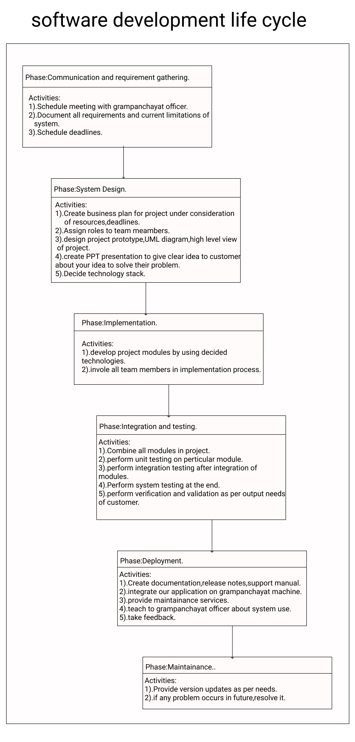
Software Devlopment Life Cycle

Slide 11
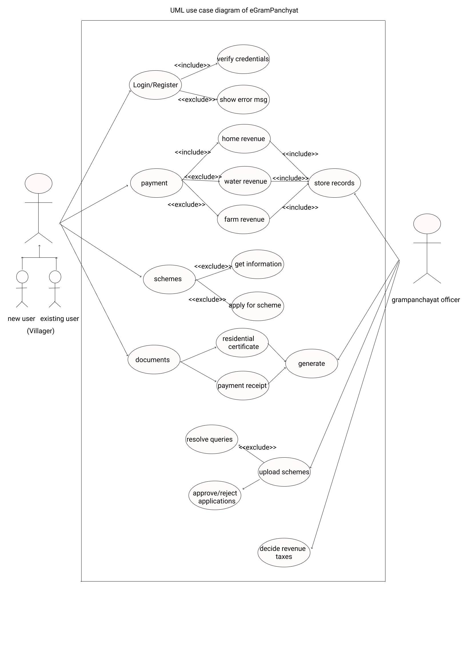
UML use case Diagram of eGram -Panchayat

Slide 12
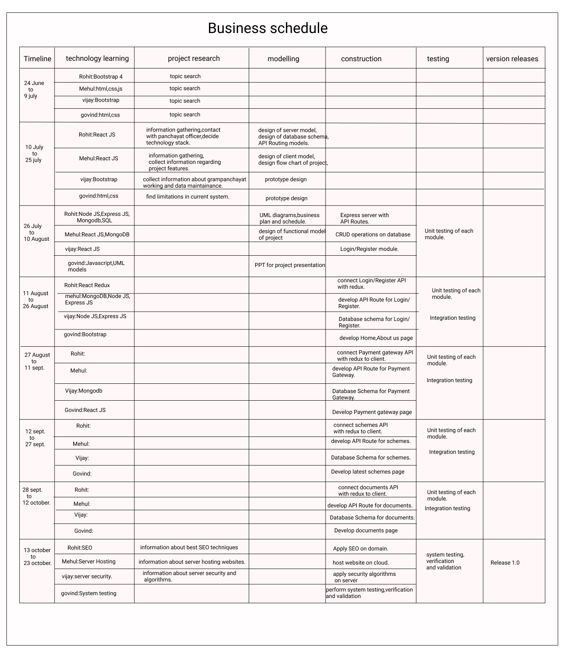
Project plan of eGram-Panchayat

Slide 13
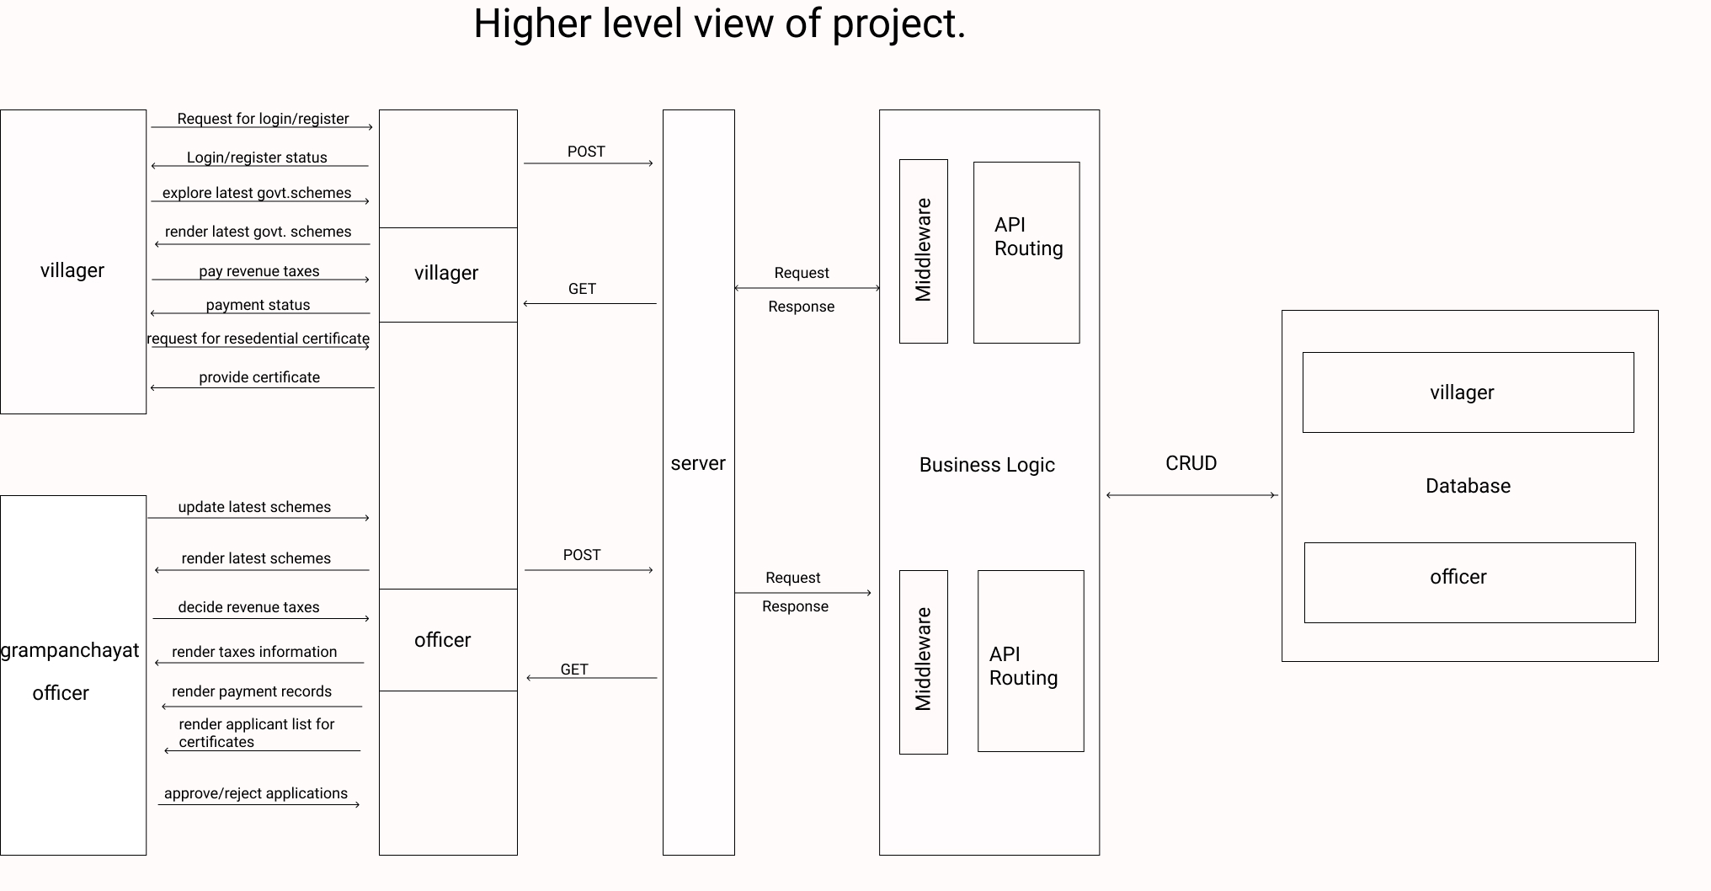
Higher Level View of project
13

Slide 14
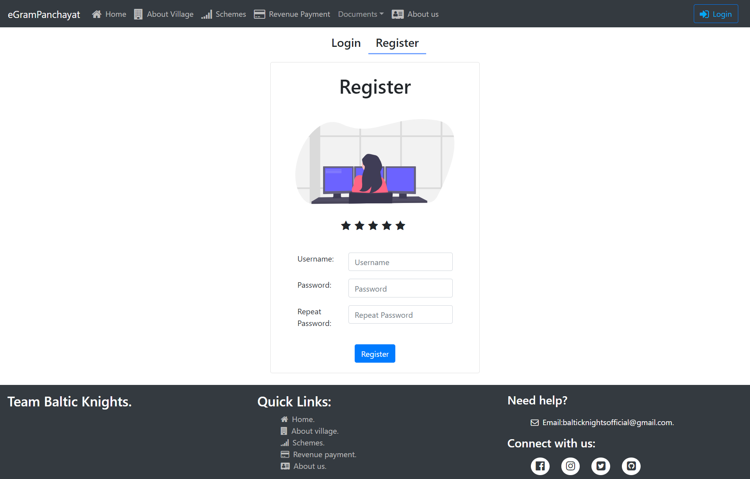
Prototype (Login Page)
14

Slide 15
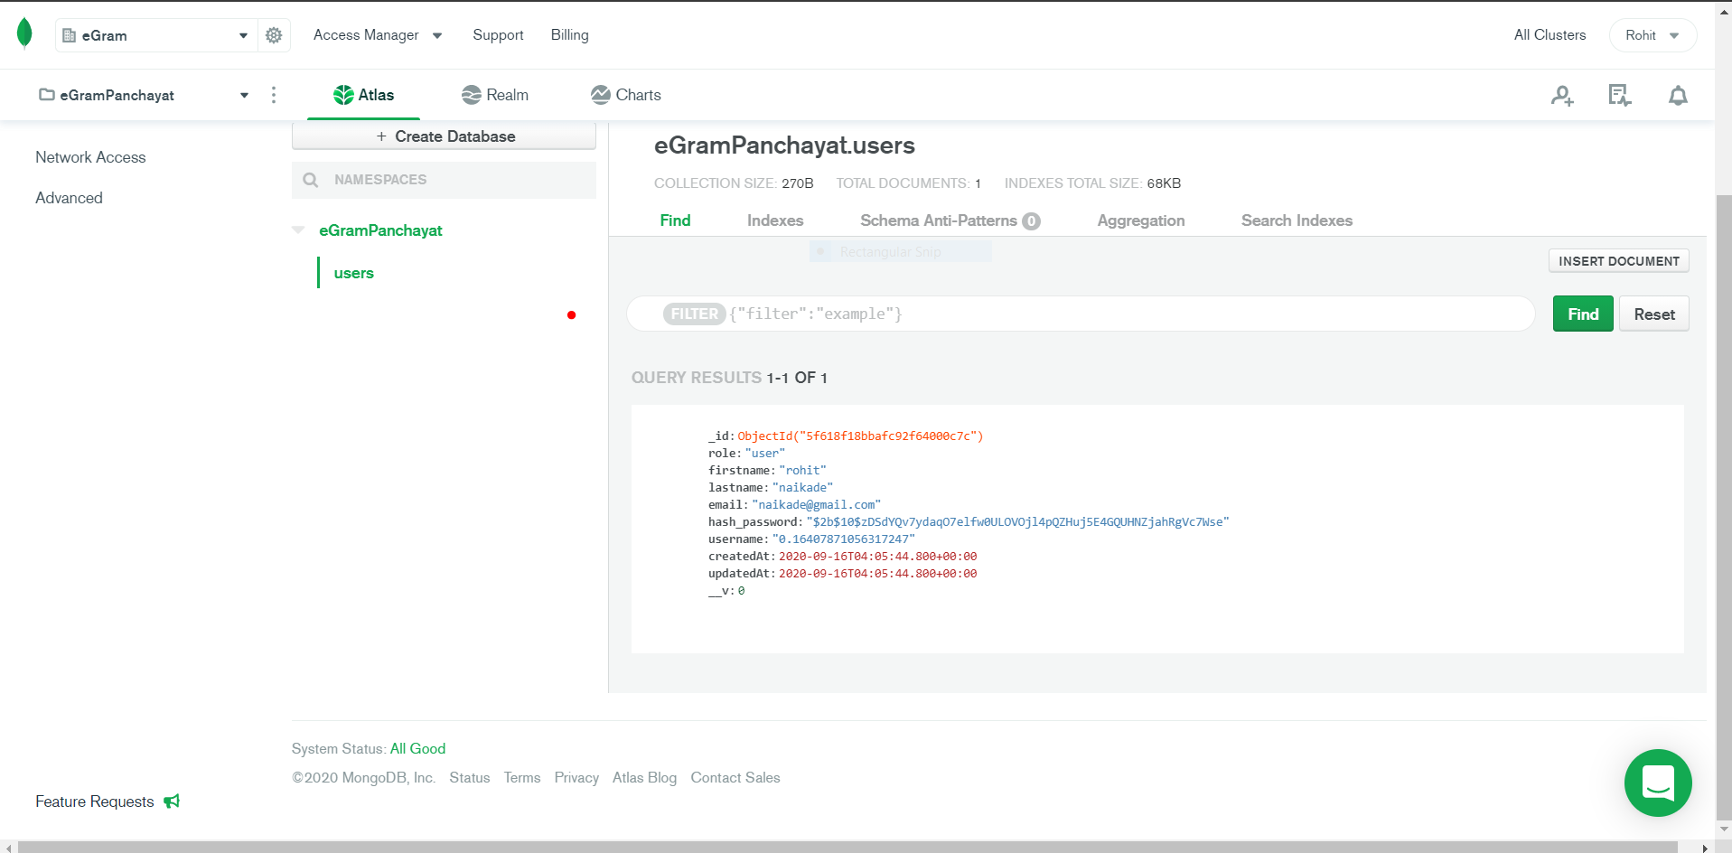
Database schema for login module.
15

Slide 16


TECHNOLOGY STACK
Front End
Networking
Server-side Development
Backend Service
16
React JS.
Bootstrap
HTML/HTML5
CSS
Client-server Architecture
Node JS
Express JS
MongoDB Atlas
Mongoose

Slide 17
ADVANTAGES
Secured and easy payment
Less data misplacement
01
02
03
04
Time saving
Technology Awareness
17
Villagers can pay revenue taxes from anywhere and anytime.
Because of less paper work,misplacment of data will reduce.
No need to visit again and again to panchayat office for residential certificate.
Villagers will get awared about using mobiles,emails and get benefit of government schemes.

Slide 18
Future Scope and Scaling
The Needy will be benefited with the schemes,as there will be no middlemen and hence no corruption.
Villagers can concentrate on farming and their duties , as time will be saved of visiting the Gram Panchayat.
The Central Government can direct keep in touch with the lowest level of democracy.
This project can be scaled to bring the Gram Panchayat at the fingertips of the Villager.

Slide 19
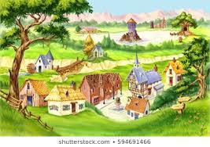
—Mahatma Gandhi,
Nationalist, and Political Leader
“
Let the villages of the future live in our imagination, so that we might one day come to live in them!

Slide 20
References.
Government portal Aatmanirbhar Bharat.
PMO portal.
React JS documentation.
Node JS,Express JS documentation.
MongoDB documentation.

Slide 21


THANK YOU
Team Baltic Knights:
Rohit Naikade (339)
Mehul Lokhande (331)
Vijay Dabhade (308)
Govind Madankar (332)

